Slide 1
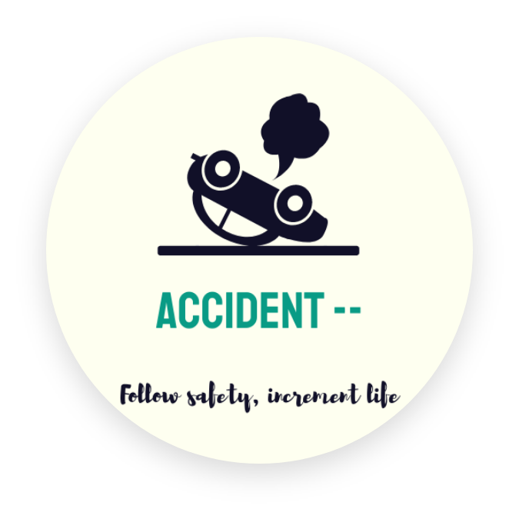
Accident--
Follow safety, increment life

Slide 2
An efficient braking system that can help us in avoiding the deathful incidents.

Slide 3
Here’s How we came up with it !!!

Slide 4
Materials
Arduino UNO
LED Display
Potentiometer
MIT App Inventor
Mobile device
Set of Wires
Just a quick purchase!

Slide 5
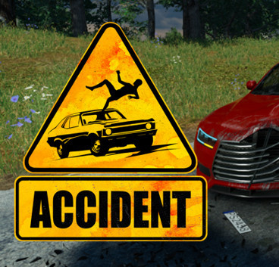


What this solves ??
It prevents a person from getting into an over-speeding accident by giving the appropriate speeding value.
It also helps an individual from tracking down by a police officer for travelling with high speed.
It solves the problem of parents by worrying less about their children since they travel the speed with value provided by the tracker.

Slide 6
“A problem is a chance for you to do your best.
Duke Ellington

Slide 7
What difficulties we had to face ??
Since the city was under lockdown, we were lacking clear goods and proper resources in order to continue to build it.
Resources, especially budget for the project, can account for a lot of time in planning a project.
The challenge will be dealing with technology or software to use. In this situation, we had to learn some advanced part of MIT App Inventor.
How did we overcome from those difficulties ??
In order to get the right resources, we had to wait until we get those resources and then plan for it.
Next thing was that we had to do is focus on our strategy on how we can implement it and keep rest of it aside.
In case of some advanced concepts of MIT App Inventor, we had to make research and watch Youtube videos in order to accomplish what we had thought.

Slide 8
The Proposed System
Our main goal is to create a parental control system, where the speed of the 2-wheeler can be controlled using mobile device.
If a person feels he has no control over his speed than he can enable a option in mobile where he will be able to drive at a certain limit.
This system can be used by parents who want their children to drive 2-wheelers safely, or the youths who want to their ride to be safe.

Slide 9
The Working
The user connects his mobile device to his vehicle.
Then he enables the GPS for live tracking of his movement.
Once he starts his vehicle, the vehicle will input the necessary data from the mobile.
Based on the value it takes the decision is done whether the vehicle has to slow down or the vehicle has to remain in its normal speed.

Slide 10
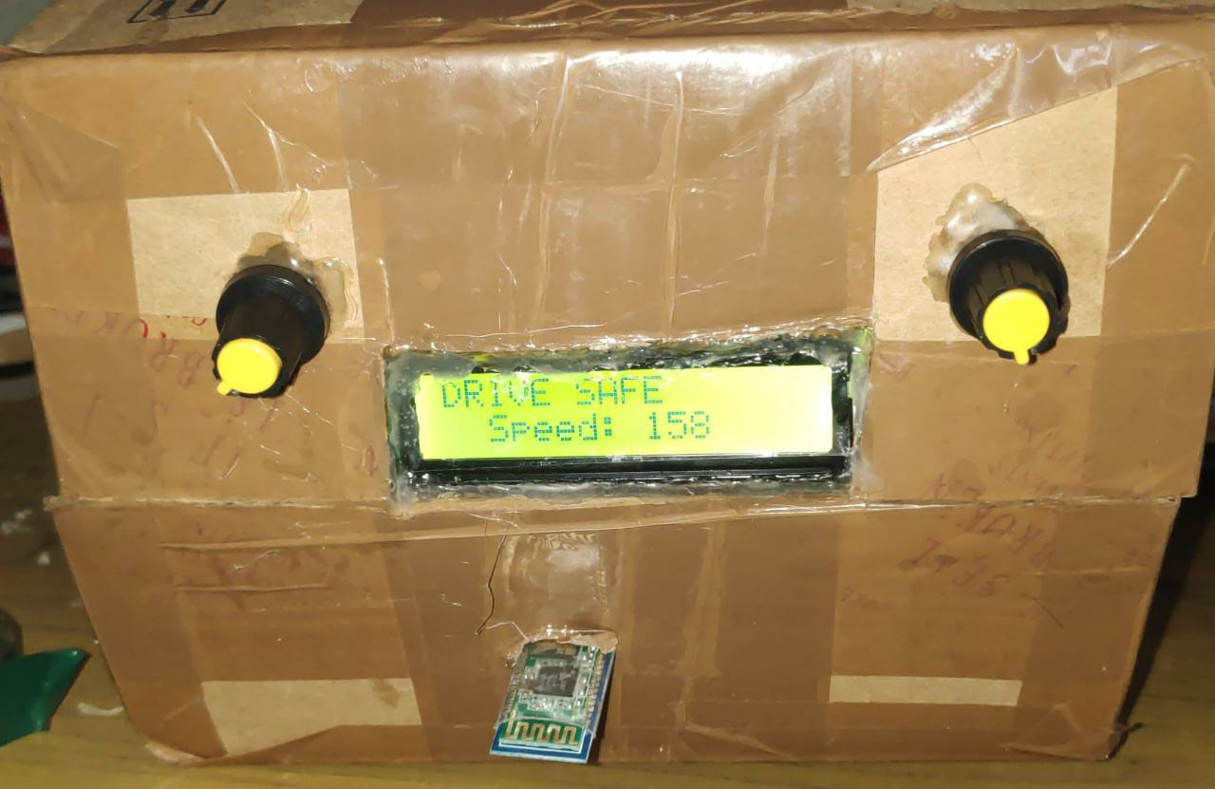
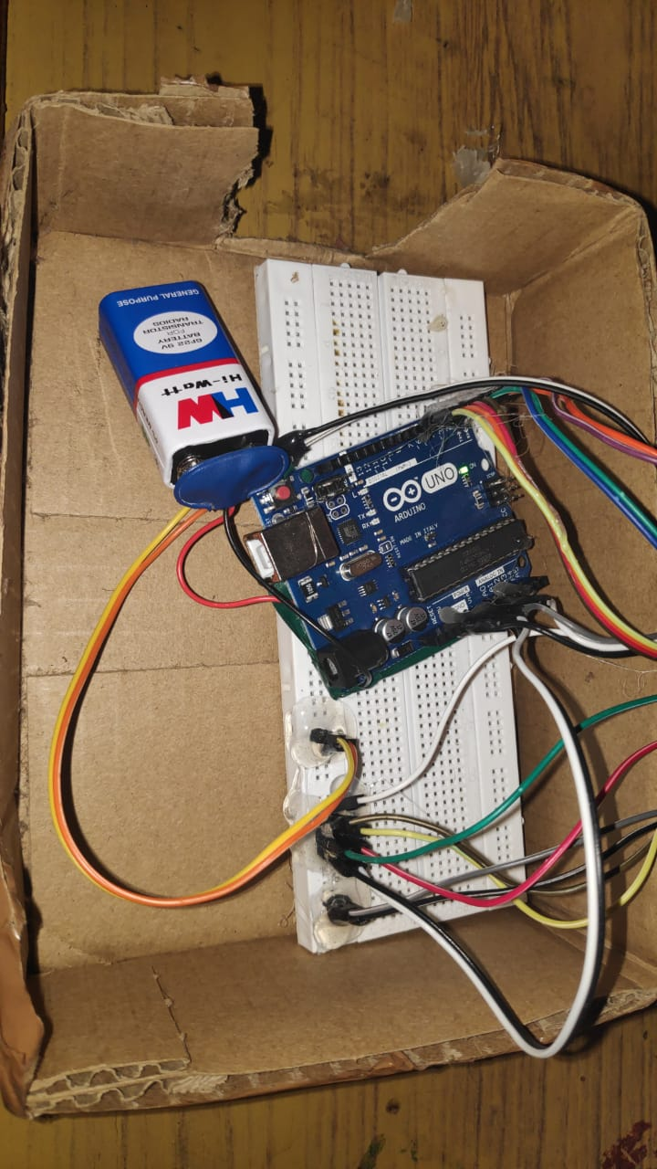
The Outcome

Slide 11
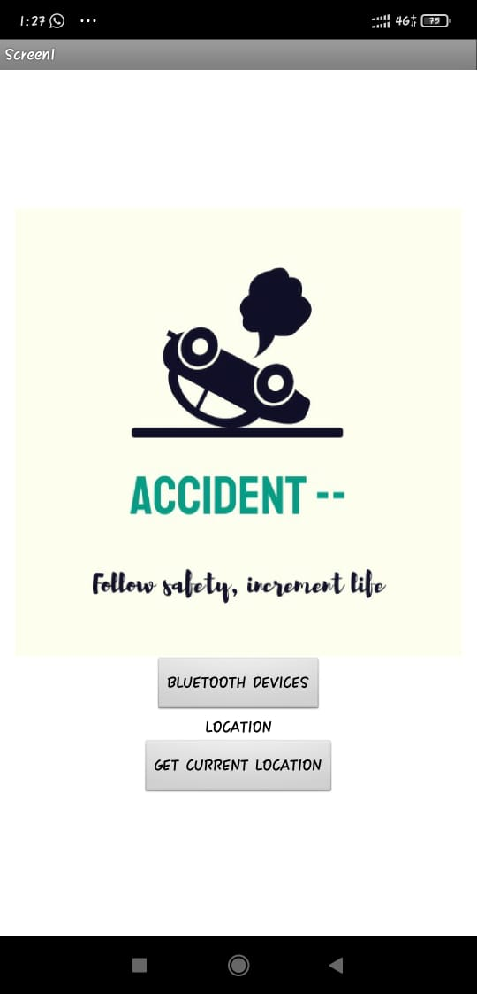
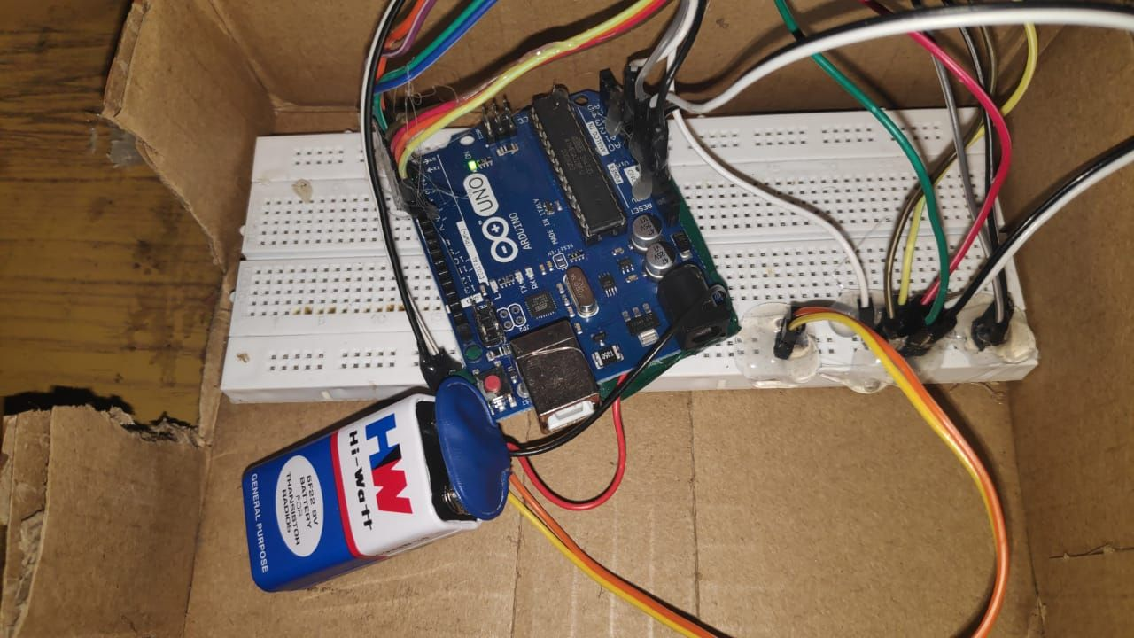
The Outcome

Slide 12
Conclusion
“40 kmph /150 kmph choice of speed is ours, choice of accidents is ours.”
At the end of the day we wish to lead a beautiful life. One small accident can change things in a devastating way. Lost lives cannot be brought back. Let us be safe and leading a cheerful life.

